Slide 1
Mapping LLVM Values to corresponding source level expression

Slide 2
But Why?
The Challenge of Understanding Compiler Optimizations:

Slide 3
But Why?
The Challenge of Understanding Compiler Optimizations:
Compilers like Clang perform complex optimizations, such as loop vectorization, to enhance program performance.

Slide 4
But Why?
The Challenge of Understanding Compiler Optimizations:
Compilers like Clang perform complex optimizations, such as loop vectorization, to enhance program performance.
Understanding why and how these optimizations occur is not always straightforward, even for experienced developers.

Slide 5
Consider an example :
void test_dependency(int n, int *A) {
for (int i = 1; i <= n - 3; i += 3) {
A[i] = A[i-1];
A[i+1] = A[i+3];
}
}
Loop does not get vectorized since it contains a backward dependency between A[i] and A[i+3].

Slide 6
Remark produced by clang with -03 and -Rpass-analysis=loop-vectorize
remark: loop not vectorized: unsafe dependent memory operations in loop. Use #pragma loop distribute(enable) to allow loop distribution to attempt to isolate the offending operations into a separate loop

Slide 7
A bit unclear right?

Slide 8
A bit unclear right?
How About this?
remark: loop not vectorized: unsafe dependent memory operations in loop. Use #pragma loop distribute(enable) to allow loop distribution to attempt to isolate the offending operations into a separate loop, Dependence Source : &A[i] and Dependence Destination : &A[(i + 3)]

Slide 9
Mapping LLVM Values to source level expression surely enhanced remark includes the exact source and destination of the dependency within the array, pinpointing the lines of code causing the vectorization issue.

Slide 10
Impact of Enhanced Remarks

Slide 11
Impact of Enhanced Remarks
Clarity: Developers can quickly identify the exact dependency that prevents vectorization.

Slide 12
Impact of Enhanced Remarks
Clarity: Developers can quickly identify the exact dependency that prevents vectorization.
Efficiency: Saves time and improves efficiency by reducing the need for deep debugging to understand optimization reports.

Slide 13
Let’s Look at our approach to solve this problem:

Slide 14
Let’s Look at our approach to solve this problem:
Approach: Utilize debug information to recreate variable and function names lost during optimization, making remarks more precise and actionable.

Slide 15
Let’s Look at our approach to solve this problem:
Approach: Utilize debug information to recreate variable and function names lost during optimization, making remarks more precise and actionable.
Hmm how to utilize that?

Slide 16
Let’s Look at our approach to solve this problem:
Approach: Utilize debug information to recreate variable and function names lost during optimization, making remarks more precise and actionable.
Hmm how to utilize that?
LLVM implementation uses a small set of intrinsics function to define a mapping between LLVM program objects and the source-level objects.

Slide 17
These intrinsic functions (name prefixed with “llvm.dbg”) helps to track source local variables through optimization and code generation.

Slide 18
These intrinsic functions (name prefixed with “llvm.dbg”) helps to track source local variables through optimization and code generation.
For us two important intrinsic functions are llvm.dbg.declare and llvm.dbg.value .

Slide 19
We can’t miss an example to understand! ☺
%i.addr = alloca i32, align 4
call void @llvm.dbg.declare(metadata i32* %i.addr, metadata !1,
metadata !DIExpression()), !dbg !2
!1 = !DILocalVariable(name: "i", ...) ; int i
!2 = !DILocation(...)

Slide 20
We can’t miss an example to understand! ☺
%i.addr = alloca i32, align 4
call void @llvm.dbg.declare(metadata i32* %i.addr, metadata !1,
metadata !DIExpression()), !dbg !2
!1 = !DILocalVariable(name: "i", ...) ; int i
!2 = !DILocation(...)
When i is allocated (%i.addr = alloca i32, align 4), llvm.dbg.declare is called with %i.addr to link the variable i with its declaration location in the source (!DILocalVariable(name: "i", ...) and !DILocation(...)).

Slide 21
And for llvm.dbg.value: If in the subsequent IR, i is updated
(%new_i = add i32 %i, 1), llvm.dbg.value can be used to indicate that i now has a new value (%new_i), linking this updated value to the variable's source-level information.

Slide 22
So, Now we know we have enough information to at least give a try to build the “source expression” if the code is compiled with debug info onn (compiled using the option –g ).

Slide 23
So, Now we know we have enough information to at least give a try to build the “source expression” if the code is compiled with debug info onn (compiled using the option –g ).
We used LLVM Intrinsic as a bridge provide detailed insights into the origins of specific IR constructs.

Slide 24
Focus on Memory Access and Vectorization

Slide 25
Focus on Memory Access and Vectorization
Importance of Memory Access Patterns: Efficient memory access is crucial for performance, especially for applications that can benefit from vectorization. Vectorization allows for multiple data operations to be performed in parallel, significantly speeding up computation.

Slide 26
Focus on Memory Access and Vectorization
Importance of Memory Access Patterns: Efficient memory access is crucial for performance, especially for applications that can benefit from vectorization. Vectorization allows for multiple data operations to be performed in parallel, significantly speeding up computation.
Project's Contribution: By providing detailed source-level mappings, the project aids in identifying inefficient memory access patterns. This insight allows developers to restructure code, ensuring that memory accesses are aligned and contiguous where possible, thereby enabling more effective vectorization.

Slide 27
Implementation Detail:

Slide 28
Implementation Detail:
For us the point of interest is load and store instruction, because we want to analyse the memory access patterns, which is useful for providing the remarks for vectorization.

Slide 29
Implementation Detail:
For us the point of interest is load and store instruction, because we want to analyse the memory access patterns, which is useful for providing the remarks for vectorization.
long foo(long *lp, long n1, long n2)
{
return lp[2 * n1 + n2];
}
If you compile above using clang -O2 -S -g -emit-llvm test.c

Slide 30
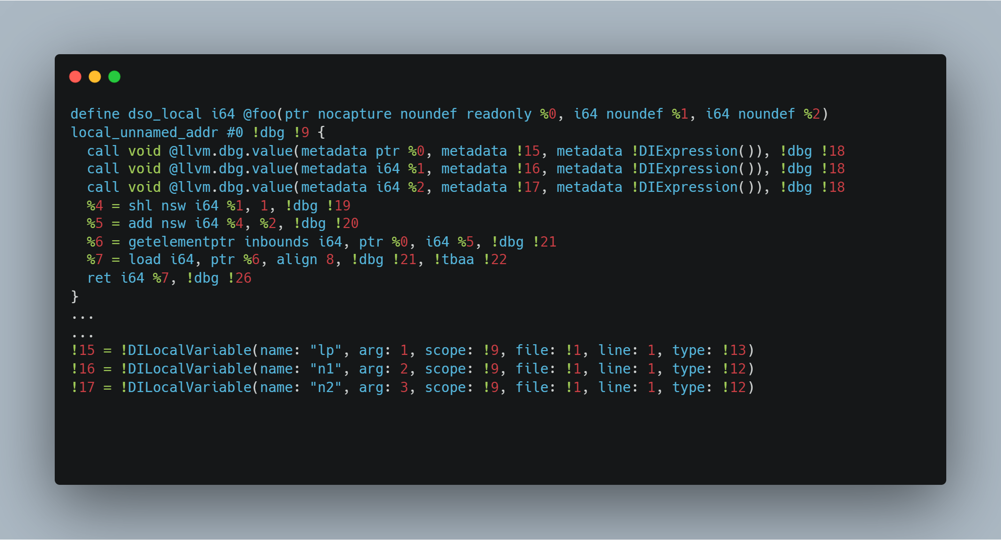

Slide 31
And we want to set this mapping for e.g.
%4 --> n1 << 1
%5 --> (n1 << 1) + n2
%6 --> &lp[(n1 << 1) + n2]
%7 --> *(&lp[(n1 << 1) + n2]) --> lp[(n1 << 1) + n2]

Slide 32
As you can see from this example:
Computing the equivalent source expressions of interest will involve walking LLVM IR and using information provided in debug intrinsics.

Slide 33
As you can see from this example:
Computing the equivalent source expressions of interest will involve walking LLVM IR and using information provided in debug intrinsics.
Even though our current interest is addresses used in load/store instructions, in order to compute the needed information we will need to compute the same for other LLVM instructions.

Slide 34
As you can see from this example:
Computing the equivalent source expressions of interest will involve walking LLVM IR and using information provided in debug intrinsics.
Even though our current interest is addresses used in load/store instructions, in order to compute the needed information we will need to compute the same for other LLVM instructions.
Optimizations may make it impossible to recover the original source expression. In the case above, for example 2 * n1 is optimized to
n1 << 1 and recovering the original expression may not be possible.

Slide 35
Implementation detail cont.
Traverse IR: Begin with a traversal of the LLVM Intermediate Representation, focusing on the structure of the function's basic blocks

Slide 36
Implementation detail cont.
Traverse IR: Begin with a traversal of the LLVM Intermediate Representation, focusing on the structure of the function's basic blocks
Identify Operations: Specifically look for load and store instructions as they are directly involved in memory access and data flow, crucial for understanding variable usage and dependencies.

Slide 37
Implementation detail cont.
Traverse IR: Begin with a traversal of the LLVM Intermediate Representation, focusing on the structure of the function's basic blocks
Identify Operations: Specifically look for load and store instructions as they are directly involved in memory access and data flow, crucial for understanding variable usage and dependencies.
Trace Operands: For each identified operation, trace back its operands. This may involve following chains of instructions to understand the origin of values.

Slide 38
Implementation detail cont.
Utilize Metadata: Check if operands or their related instructions are associated with debug metadata. This metadata, generated with the
-g option during compilation, includes crucial source-level information like variable names.

Slide 39
Implementation detail cont.
Utilize Metadata: Check if operands or their related instructions are associated with debug metadata. This metadata, generated with the
-g option during compilation, includes crucial source-level information like variable names.
Reconstruct Expressions: Leveraging the traced instructions and metadata, reconstruct the equivalent source-level expression. This involves understanding the semantics of the LLVM IR instructions and how they map to source code constructs.

Slide 40
Current State
Not yet upstream to LLVM. PR [Analysis][LV] Map LLVM values to source level expression by phyBrackets · Pull Request #66591 · llvm/llvm-project · GitHub
We need more review on the patch and some active work from me and if any of you interested.
Struct pose a unique challenge due to their intricate representation with the IR.
Accurate source level expression in case of optimization is still a problem.
There isn’t always a 1:1 mapping between source code and IR: sometimes multiple source code constructions result in the same IR, e.g. *ptr and ptr[0]. Which pattern should be used when there are multiple options?

Slide 41
Thank You for Listening!
Reach Out to me in case any of you interested in knowing more about the project and the algorithm.
Contact : physhivam@gmail.com
Discord : @phybrackets

