Slide 1
Chorus - Effortless Ceph S3 Petabyte Migration
FOSDEM 2024
Sirisha Guduru
Ceph Engineer
sirisha.guduru@clyso.com

Slide 2
Why data migration?
Traversing through the lifecycle phase of replacing cluster hardware and the necessity to build a new cluster when the existing cluster cannot be augmented Data migration between an old cluster (EOL) and a newly built cluster

Slide 3
Migration and its woes
Data migration is a herculean task!!
Challenges with syncing petabytes of data across clusters Continuous monitoring and time consumed Tools used for migration Continuous changes in the data (writes and updates on the buckets)

Slide 4
Our experience with data migration
The Ceph cluster hardware was EOL. We built a new cluster from scratch +3PB of data was to be migrated between old and new clusters Used rclone as data migration tool Migration of user accounts along with access and secret keys, ACLs and bucket policies from old cluster to new was a tough task. Buckets and live data were copied using rclone seamlessly run in parallel.

Slide 5
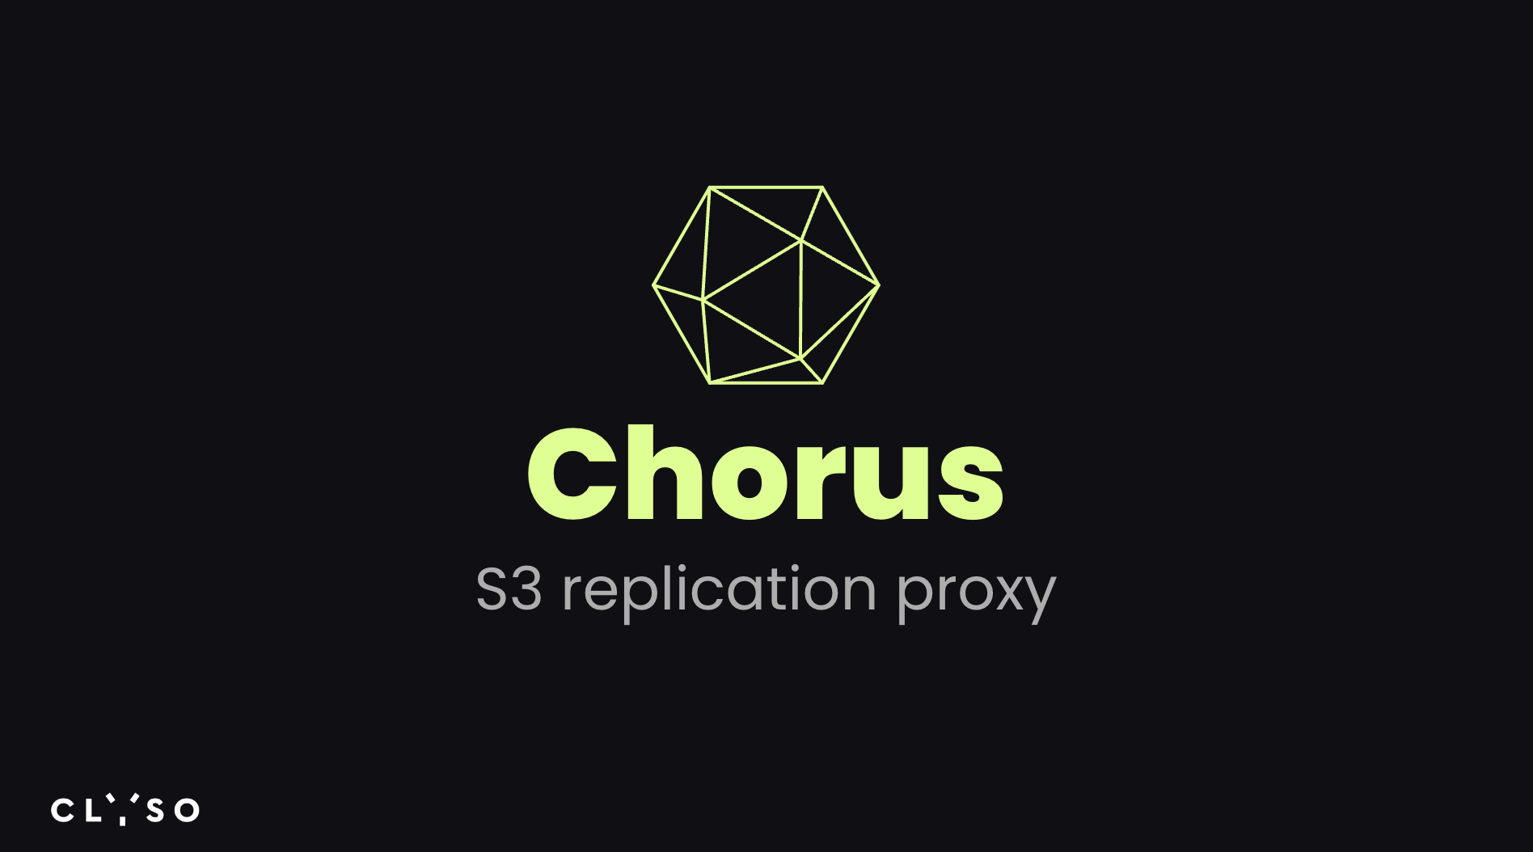
Chorus
These learnings led to the development of a tool called Chorus which is a data replication software capable of synchronizing S3 data between multiple cloud storage backends. https://github.com/clyso/chorus

Slide 6
Chorus
Problem
How to migrate to a different S3 vendor with reduced downtime?
How to backup S3 data to another S3 in different region and different vendor?

Slide 7
Chorus Overview
Overview
One main storage and followers.
Chorus S3 API.
Requests are routed to main storage and async replication to followers.
All existing data is also replicated from main to follower in background.
Data replication can be configured, paused, resumed by user by bucket with web admin UI or CLI
Notes:
Users inputting storage credentials into the Chorus configuration.
One storage is selected as the main while others become followers.
Once configured and started, Chorus's S3 API can be used instead of the main storage's API.
Chorus proxies requests to the main storage and asynchronously replicates the data to follower storages.
All existing data is also replicated from main to follower in background.
Data replication can be configured, paused, resumed by user by bucket with web admin UI or CLI

Slide 8
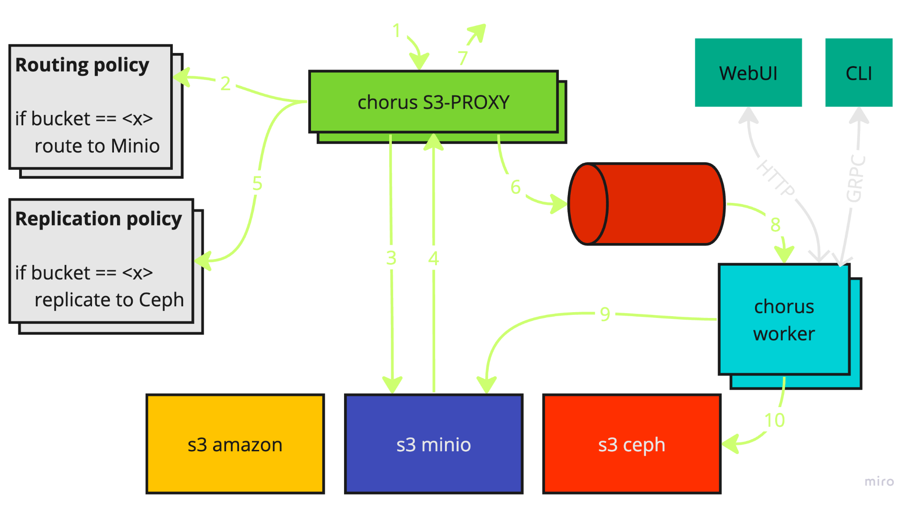

Slide 9
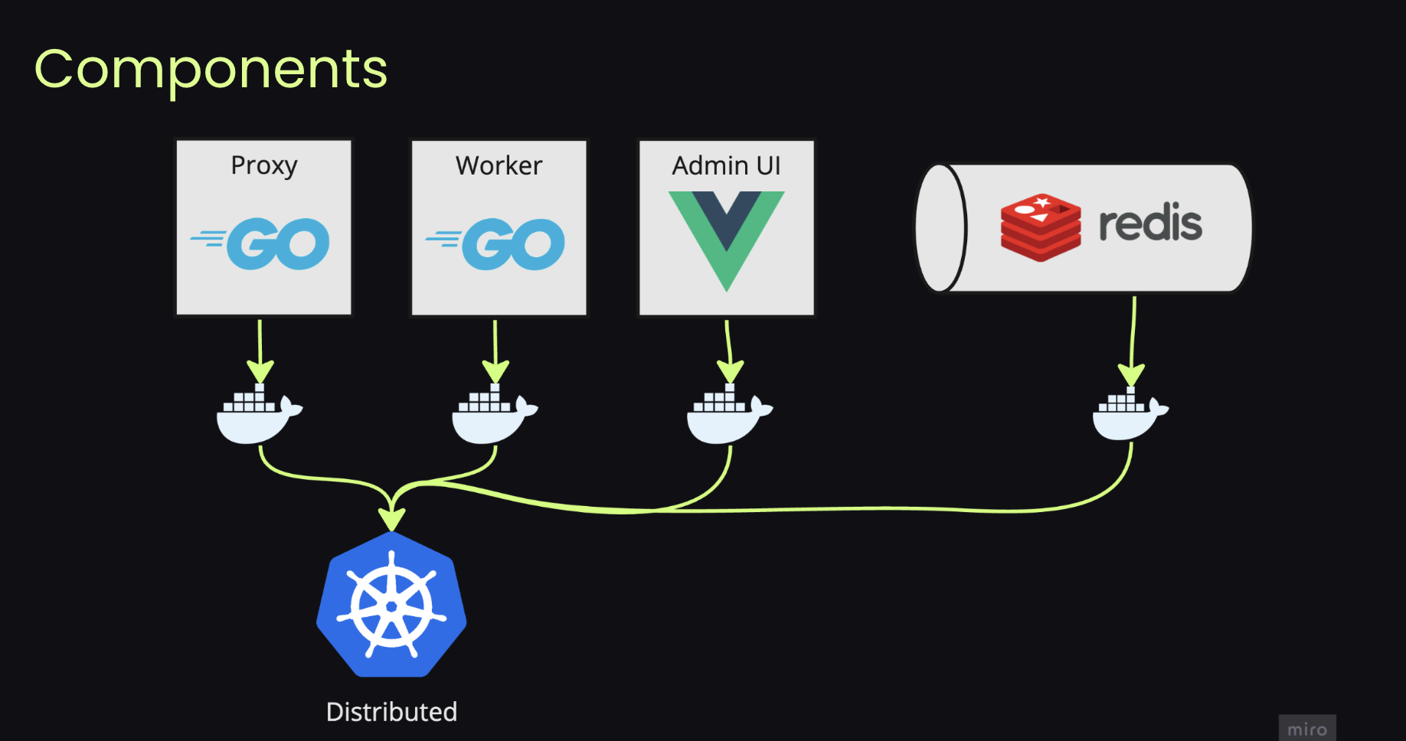
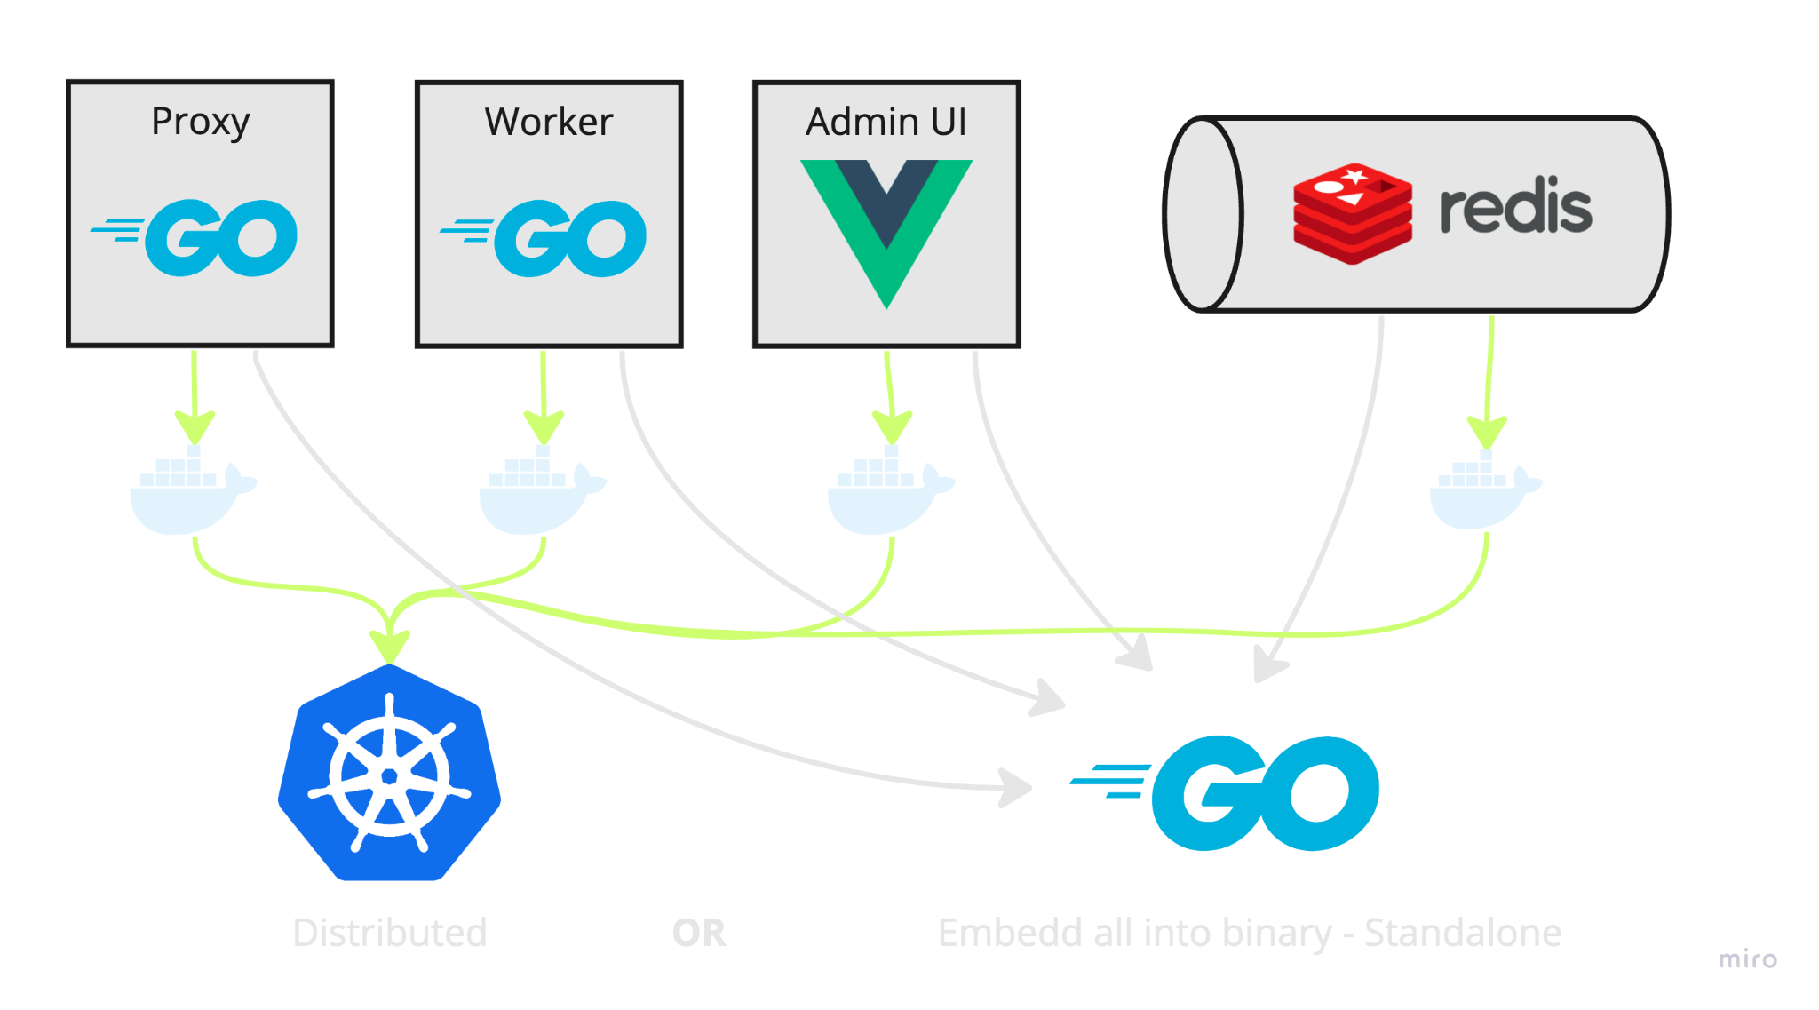

Slide 10
Chorus
Proxy:
Routing & replication per bucket, PAUSE & RESUME
Map custom credentials
Worker:
Sync obj/bucket meta, content, tags, ACLs.
Migrate existing data in background
Track replication lag in prometheus <-> autoscale workers
Rate limit (RAM, network)
Features

Slide 11
Chorus
Proxy:
stateless, low-memory, low-CPU, high-network.
Redis:
Scale: Redis cluster.
Persistence: AOF, snapshot (RDB).
Memory: 1M obj ~ 105MB, 1M queue ~ 700MB
Low cpu: 100-1000 rps during migration
Worker:
Stateless, high-memory, high-network, low-CPU.
Tune worker resources and rate-limit <-> queue size & replication lag
Operations

Slide 12
Chorus
Have working vendor-agnostic solution fast
pluggable architecture
learn, play-around
benchmark
Focus on correctness
Migrate big bucket under the load without downtime
Initial Goals

Slide 13
Chorus
More load tests.
API Cost/Resource optimization.
Routing policy alternatives: route by obj size, meta, etc…
Load balance read requests for replicated data.
Chorus agents: subscribe to bucket notification/event log instead of proxy.
Swift API compatibility
Lifecycle policy
Next steps

Slide 14
Questions

Slide 15
Chorus
Use Cases
Active transparent proxy
Active transparent proxy -migration
Backup service
Ransomware protection
Client deployment
Global namespace
Outlook

Slide 16
Chorus
Resources
https://docs.clyso.com/docs/products/chorus/overview/
https://docs.clyso.com/blog/2024/01/24/opensourcing-chorus-project/
https://github.com/clyso/chorus

Slide 17
Thank You!
Contact: sirisha.guduru@clyso.com

